Slide 1

Emerging Trends in Racing Games
Victor Shu

Slide 2

Racing Game
Players partake in a racing competition with vehicles
From real-world racing leagues to entirely fantastical settings
First-person or third-person

Slide 3

According to Wikipedia…

Slide 4

There are over 600 racing games since 1970s!

Slide 5
Who are these racing games targeting at?

Slide 6
Several well-known titles involved
Mario Kart 8 Deluxe
2017
Nintendo
Gran Turismo Sport
2017
Sony Interactive Entertainment
Forza Horizon 3
2016
Microsoft Studio
Several other titles released recently

Slide 7

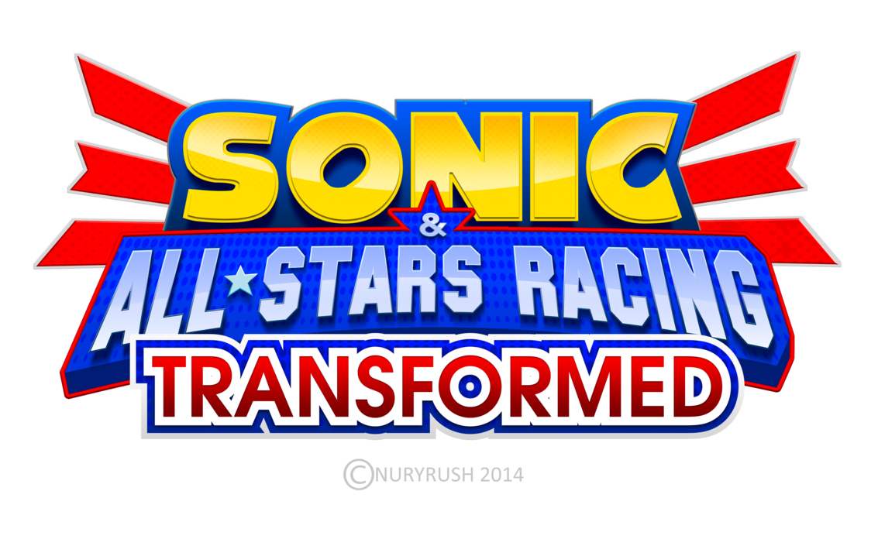
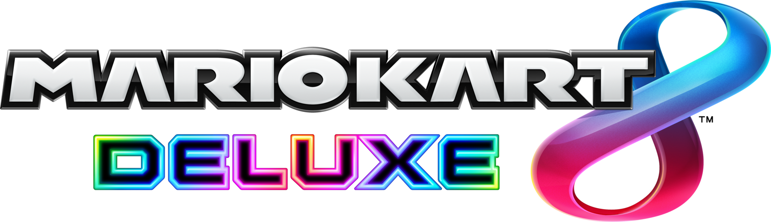




They have different graphics
Cartoonish
Realistic

Slide 8


They have different gameplay
Casual driving experience
Driving Simulator

Slide 9
If we categorize them…

Slide 10
Simulator
No Such Game
As far as I know
Cartoonish
Realistic
Casual

Slide 11
We can see who they are targeting at

Slide 12
Simulator
No Such Game
As far as I know
Players who pursue the real and hardcore driving experience
Cartoonish
Realistic
Kart games that targeting at families and both adults and children
Players who want experiences like open-world, drifting or stories with real cars in real world
Casual

Slide 13
Their communities are also different
Kart games usually played in parties
Casual driving games is a place for gamers to talk about cars
Players compete in hardcore driving simulators

Slide 14

Summary
Graphics are not so good in older times
When we have great GPUs, racing games start to have subclasses
Games stay at cartoonish styles become good party games
Games with good realistic graphics are good places for players to communicate and experience cars
Players who are fans of hardcore driving simulators usually compete

Slide 15
Thanks!
Victor Shu

